Slide 1
Royal Docks Enterprise Zone Programme Board
Board Membership
Application Pack
October 2024

Slide 2
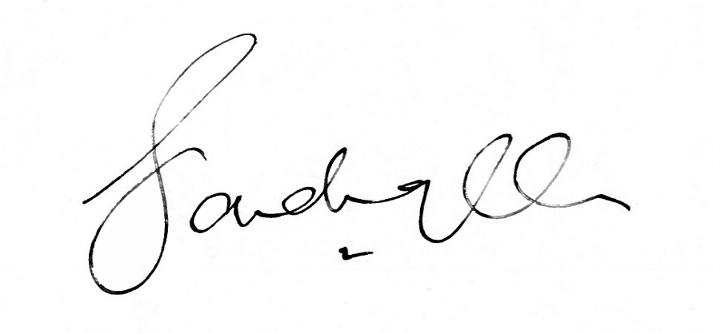
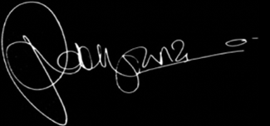
Dear Applicant,
Membership of the Royal Docks Enterprise Zone Programme Board. Thank you for your interest in becoming a Member of the Royal Docks Enterprise Zone Programme Board.
This Recruitment Pack provides you with information on the Board’s role and responsibilities and details about the application process for the role of a Member.
For a confidential discussion about the positions, please contact Daniel Bridge
Daniel.bridge@royaldocks.london.
We look forward to receiving your application. Yours sincerely, Sadiq Khan Mayor of London
Rokhsana Fiaz OBE
Mayor of Newham

Slide 3
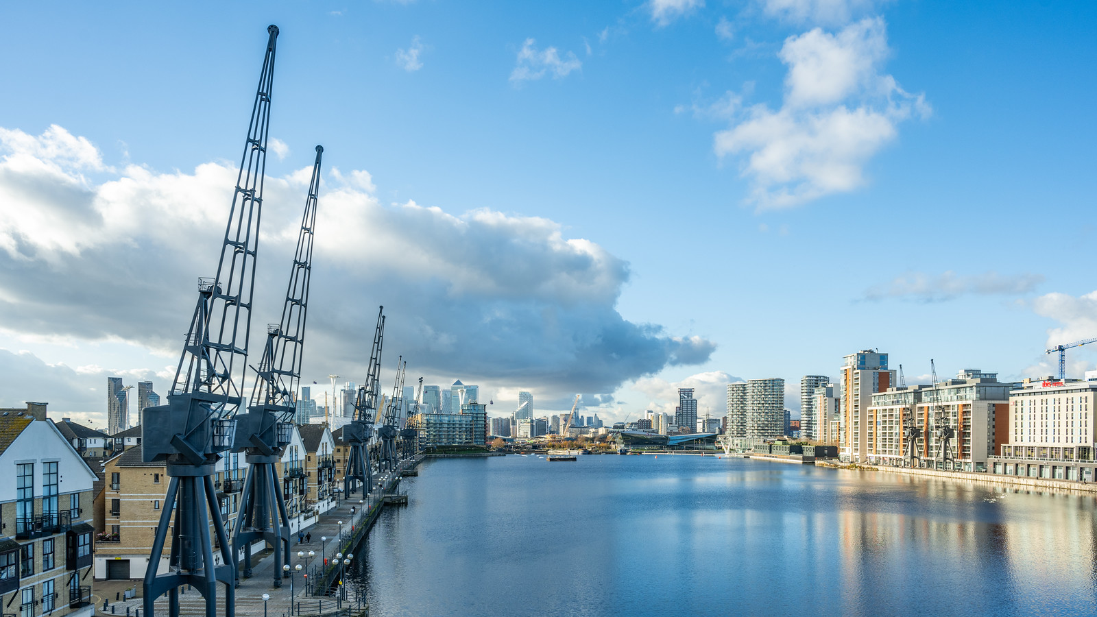
Contents
Introduction
About the Royal Docks Enterprise Zone Programme Board
Membership and Governance
Role Specification
Appointment Details
Appointment Process

Slide 4
1. Introduction
This is an exciting opportunity to shape the next stage of the Royal Docks by joining the Royal Docks Enterprise Zone Programme Board, co-chaired by Rokhsana Fiaz OBE, Mayor of Newham and Tom Copley, Deputy Mayor of London for Housing and Residential Development.
The Royal Docks is one of London’s largest regeneration and investment opportunities, at the centre of an expanding east London region. Once the UK’s gateway to world trade, today the Royal Docks is re-emerging as a major new business and visitor destination, with approximately £5 billion worth of investment planned over the next 20 years, delivering up to 36,000 new homes, 55,000 new jobs and up to 4 million square feet of commercial space.

Slide 5
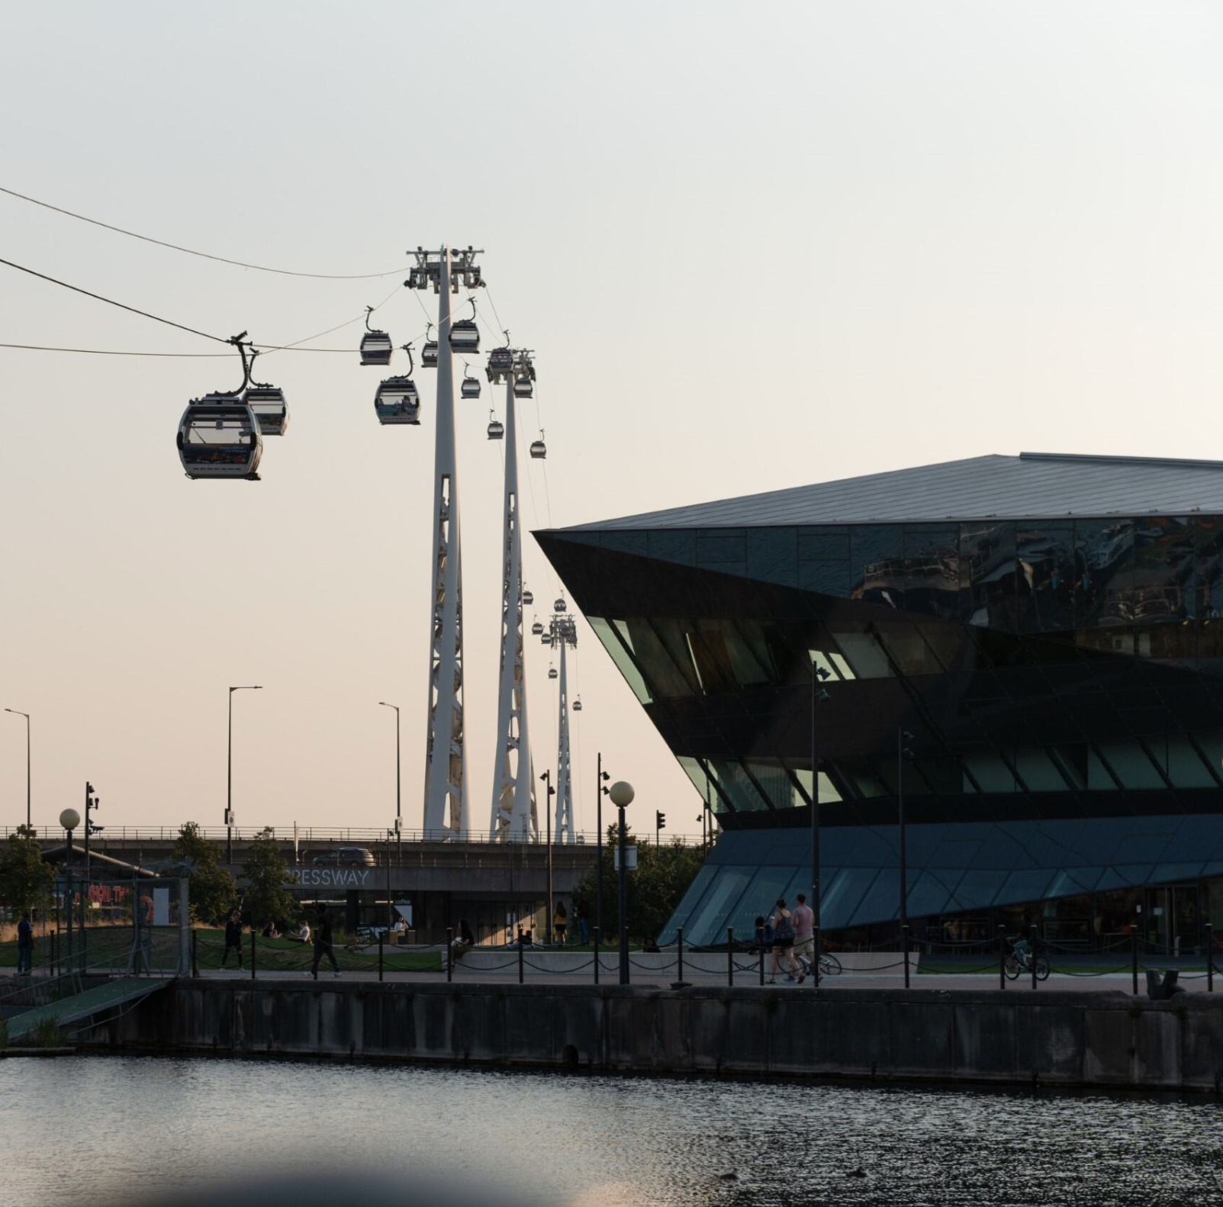
The Mayor is looking to appoint three Members
with expertise in one or more of the following:
• economic growth and development
• the night-time economy, retail, hospitality
• social infrastructure
• environmental sustainability
• cultural placemaking
• marketing
• community engagement.

Slide 6
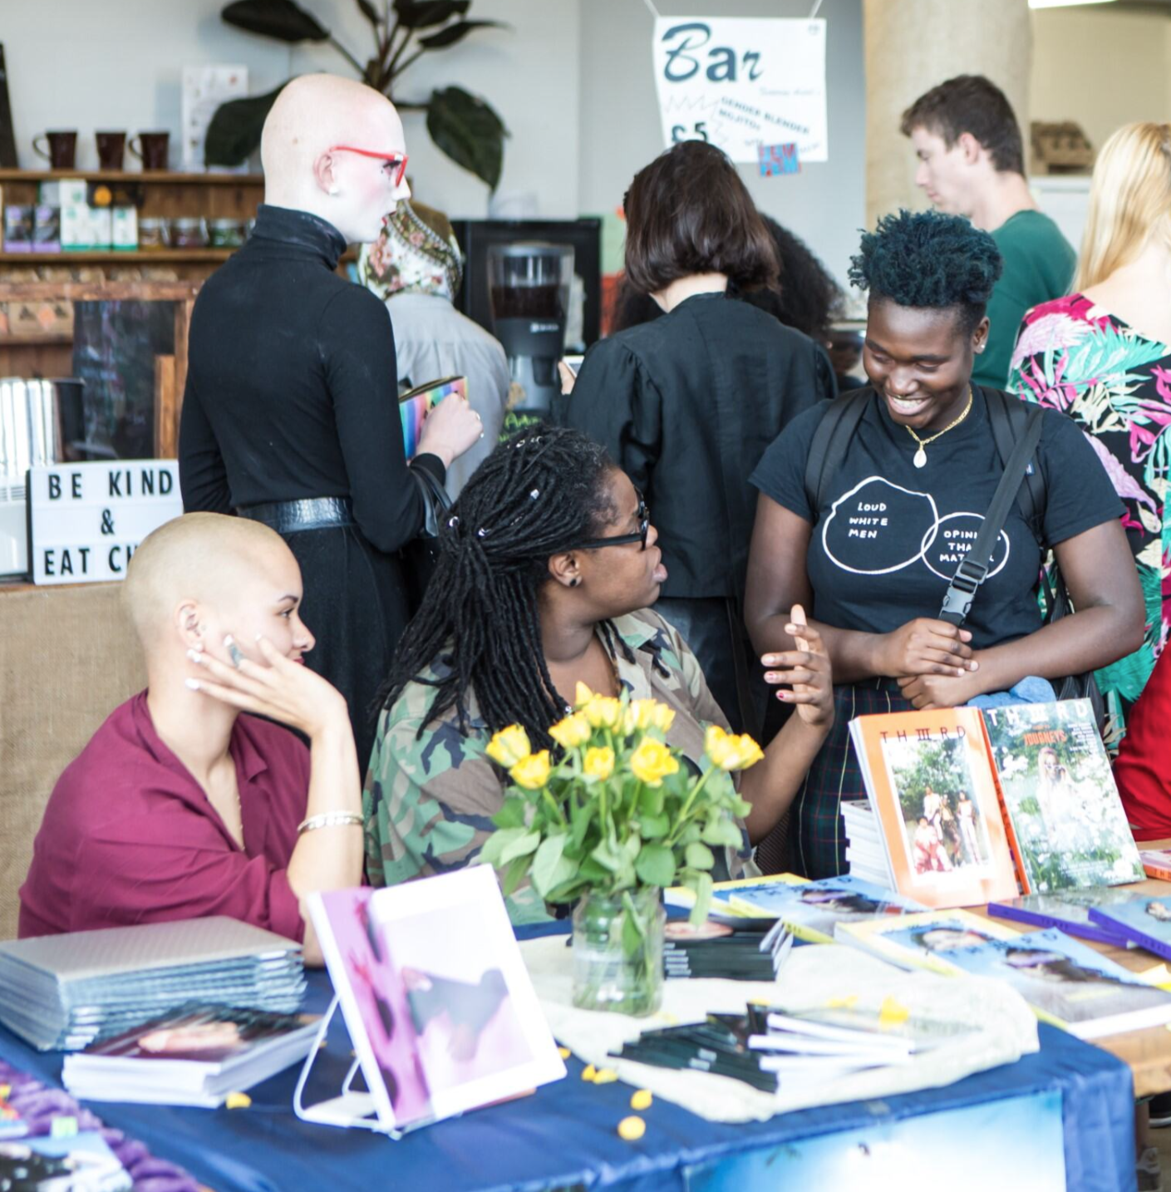
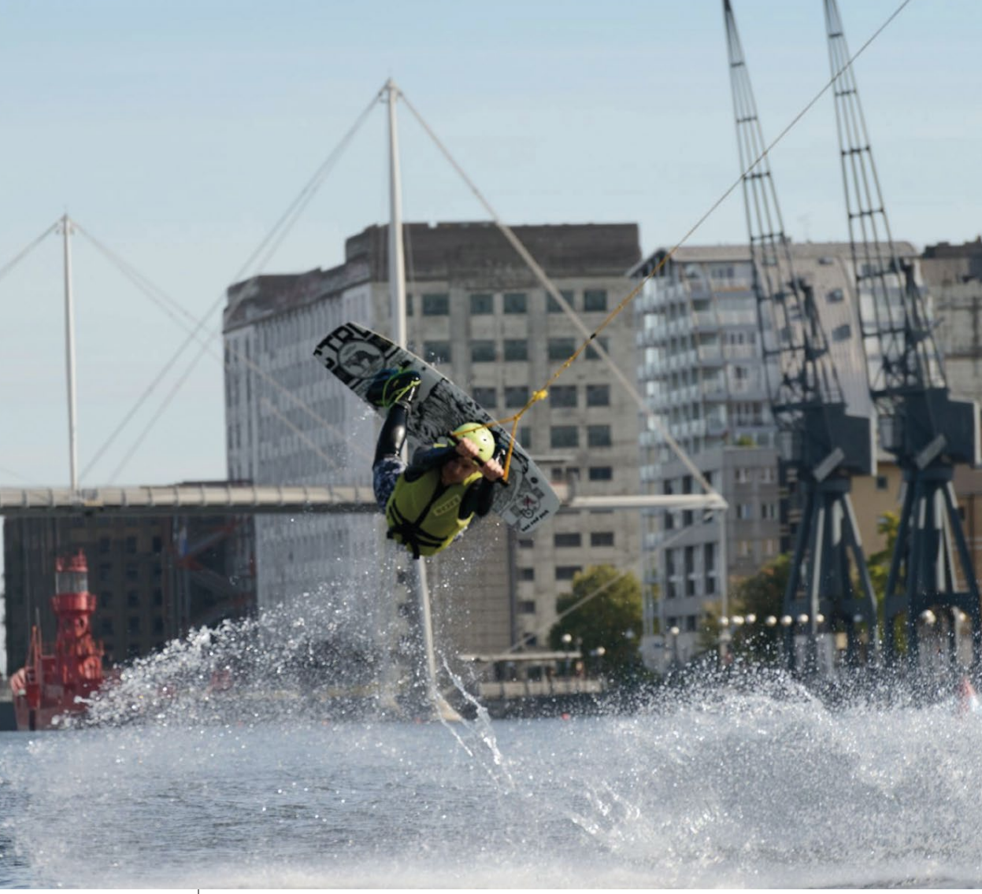
We are absolutely committed to better representing the diverse communities we serve in east London and are looking for people who share this passion.
We’re keen to hear how your work and lived experiences make you suitable for the role of board member, and we’d especially welcome applications from people based in our local communities, and those from traditionally underrepresented groups.

Slide 7
Above all, we want to understand how you will give us a better representation of the perspectives of those we are here to serve, and how you can help us to continuously support and develop our inclusive culture.
We are particularly interested in applicants who live or work in east London from the business, voluntary or community sectors, including a prominent member of the Newham business community.
We strongly welcome and encourage applications from individuals who identify as female, come from culturally diverse backgrounds, or have a disability.

Slide 8
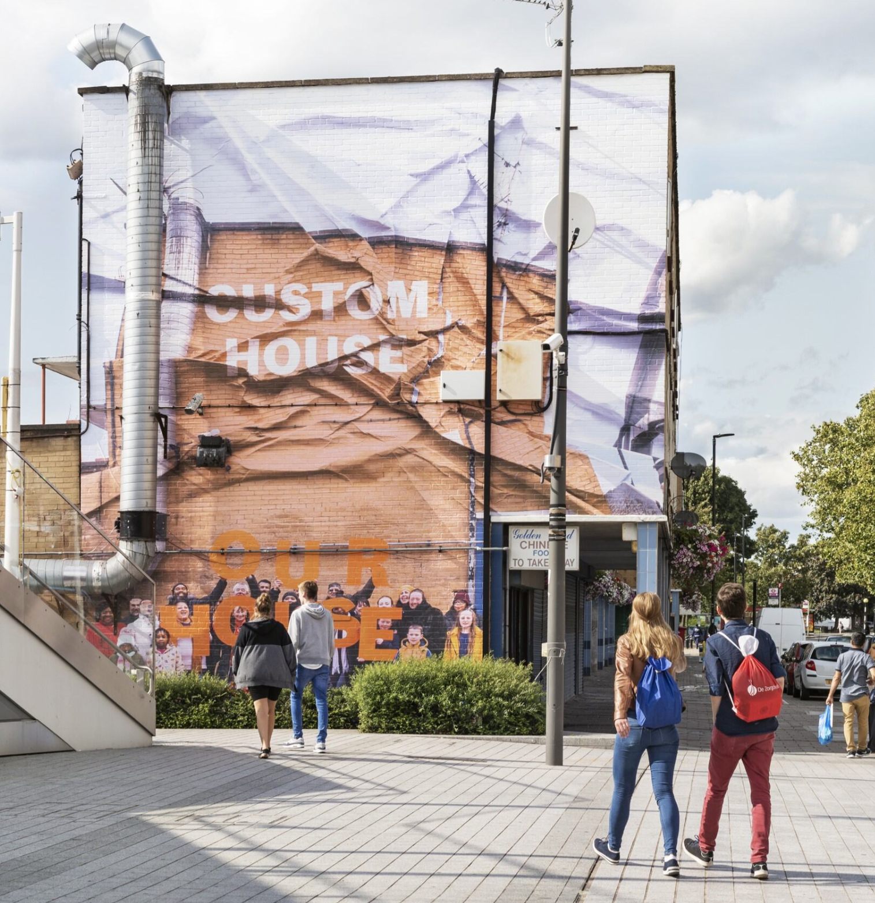
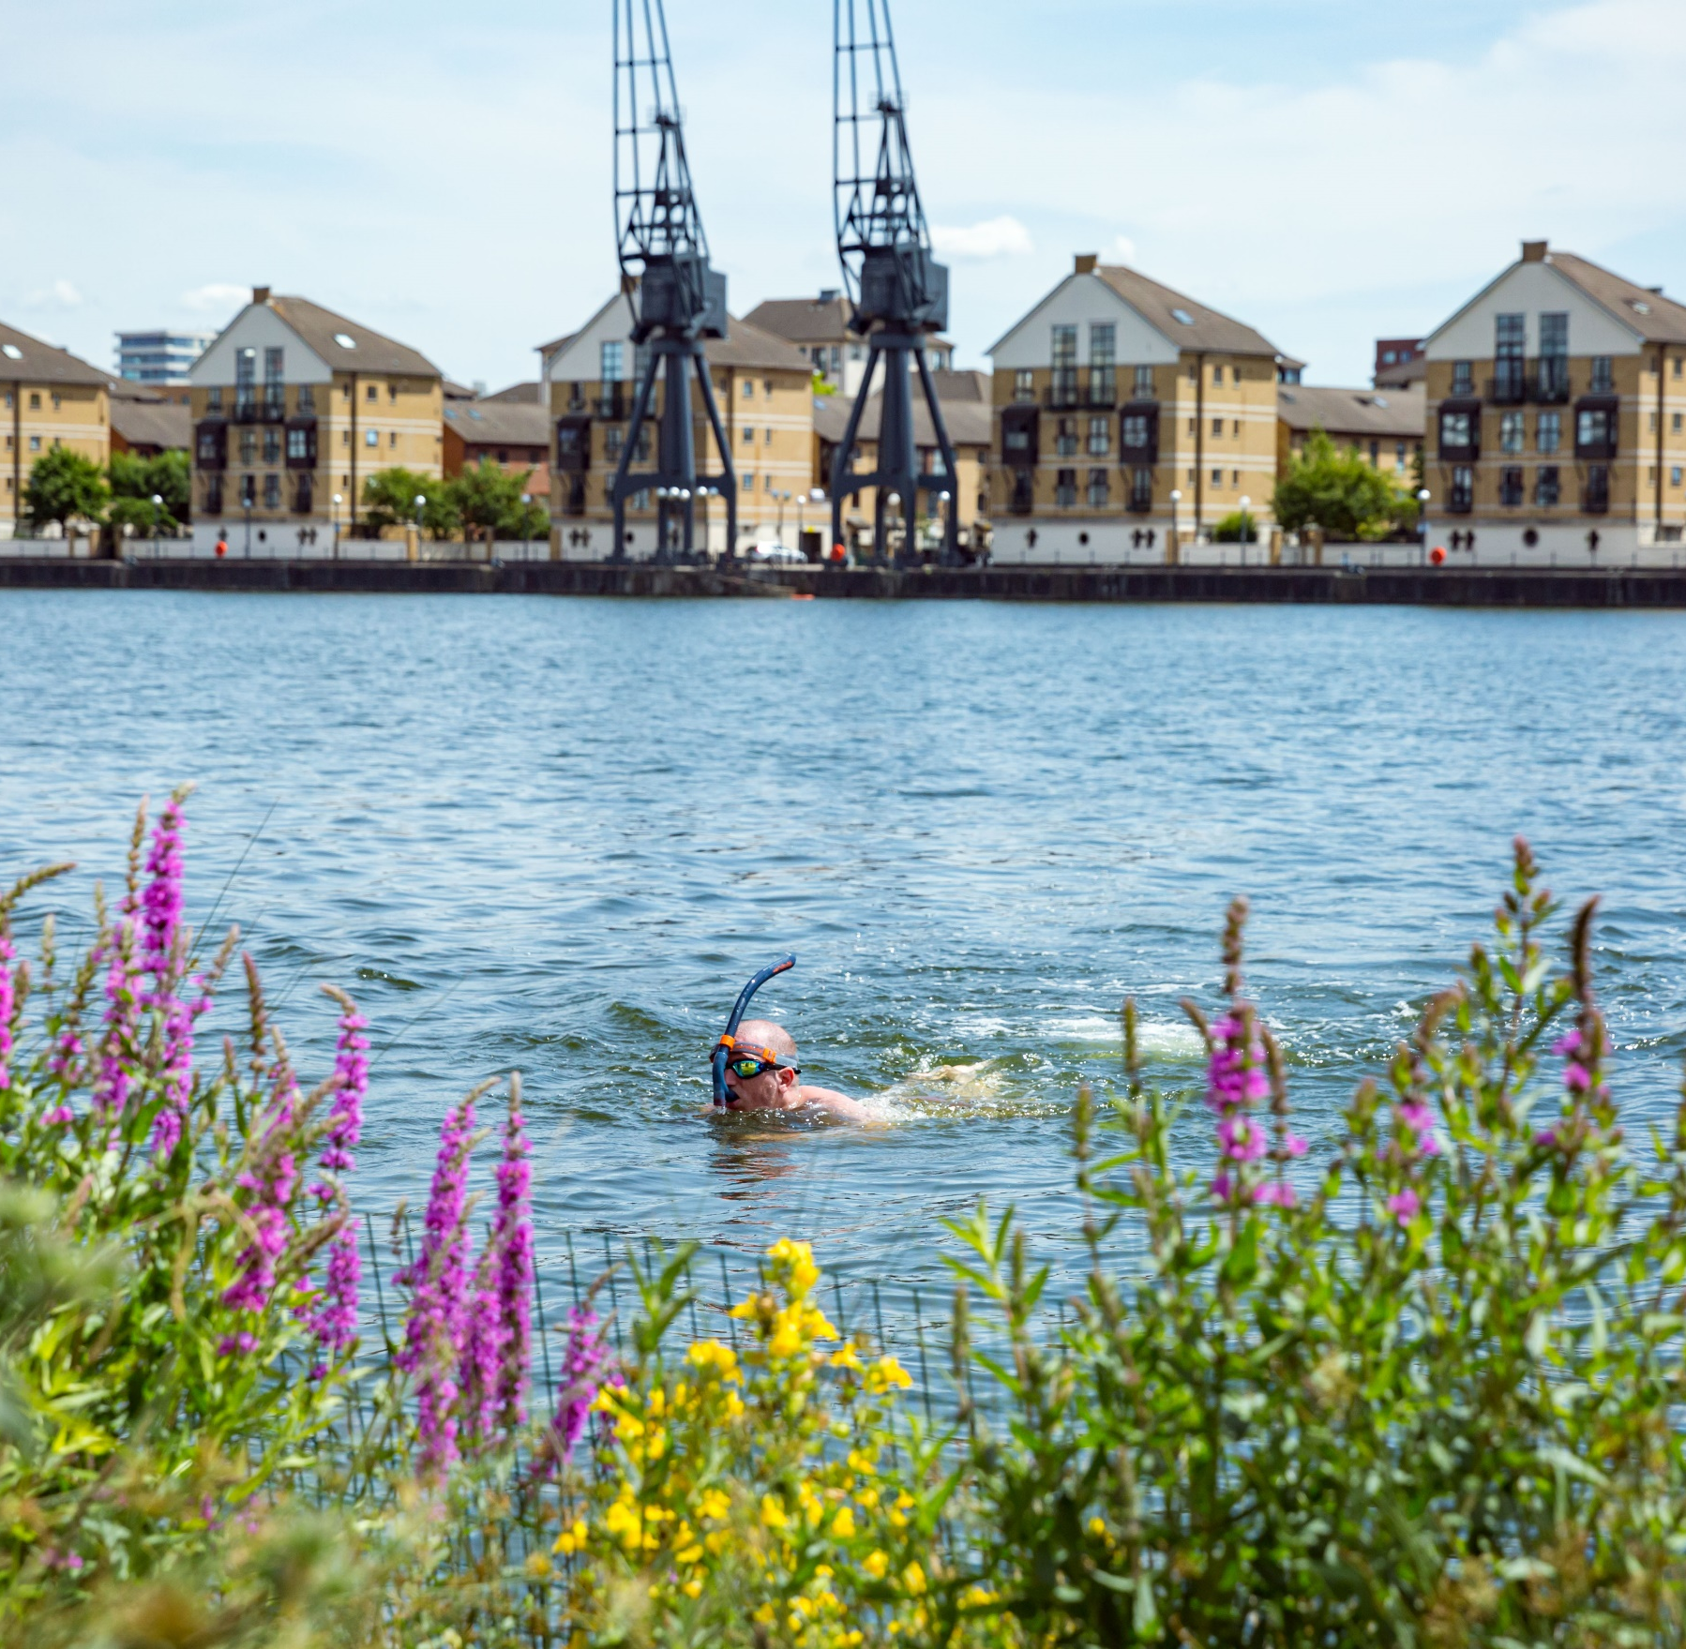
2. About the Royal Docks Enterprise Zone
The Royal Docks is one of the largest regeneration areas in London, with seven significant developments being brought forward across 175 hectares of public land belonging to the Greater London Authority (GLA), representing a mix of residential, commercial, and industrial developments.
Approximately £5 billion of investment is planned for the area over the next 20 years.
The area’s designation as an Enterprise Zone (EZ) has helped unlock significant public-sector investment and the establishment of a dedicated Royal Docks delivery team that is helping to coordinate the area’s comprehensive redevelopment.

Slide 9
Over the last five years, the Mayors of London and Newham have jointly been delivering a comprehensive regeneration programme that will restore the former docks into a thriving, new waterside destination.
This includes more than 9,000 new homes built or under construction; 40,000sqm of commercial space completed with another 25,000sqm under construction; approximately 2,620 new jobs created; £37.4 million invested across more than 20 public realm projects improving the quality and sense of place; over 270 cultural projects produced, attracting over 300,000 attendees; and the establishment of the Royal Docks as a Living Wage place, where a growing number of employers have signed up to paying a fair wage.
The Mayor of London and Mayor of Newham launched the new five-year Royal Docks Delivery Plan on 7 March 2024 with an overall investment of £64.31 million (£21.58 million revenue and £42.73 million capital) to be delivered in the area over the five-year delivery period. The plan is structured around three strategic outcomes:

Slide 10
• Prosperity, Growth & Investment
The Royal Docks will become an established economic stronghold for London, home to a diverse mix of businesses and industries. The area’s growing commercial offer and innovation ecosystem will attract new investment, enable entrepreneurial activity, and create local skilled jobs.
• Sustainability & Wellbeing
The Royal Docks will lead the way in sustainable investment and development, with six distinct waterside neighbourhoods that provide resilient, happy, healthy places for nature and residents to flourish.
• Culture & Community
Building on the area’s existing communities and growing cultural ecosystem, the Royal Docks will evolve as London’s Cultural Engine. New public spaces, waterfront and cultural amenities, and affordable creative and production workspaces, will make the Royal Docks one of the most exciting and varied places in London to live, work and play.
Further information on the latest delivery plan can be found here: The 2024-2029 Royal Docks Delivery Plan.

Slide 11
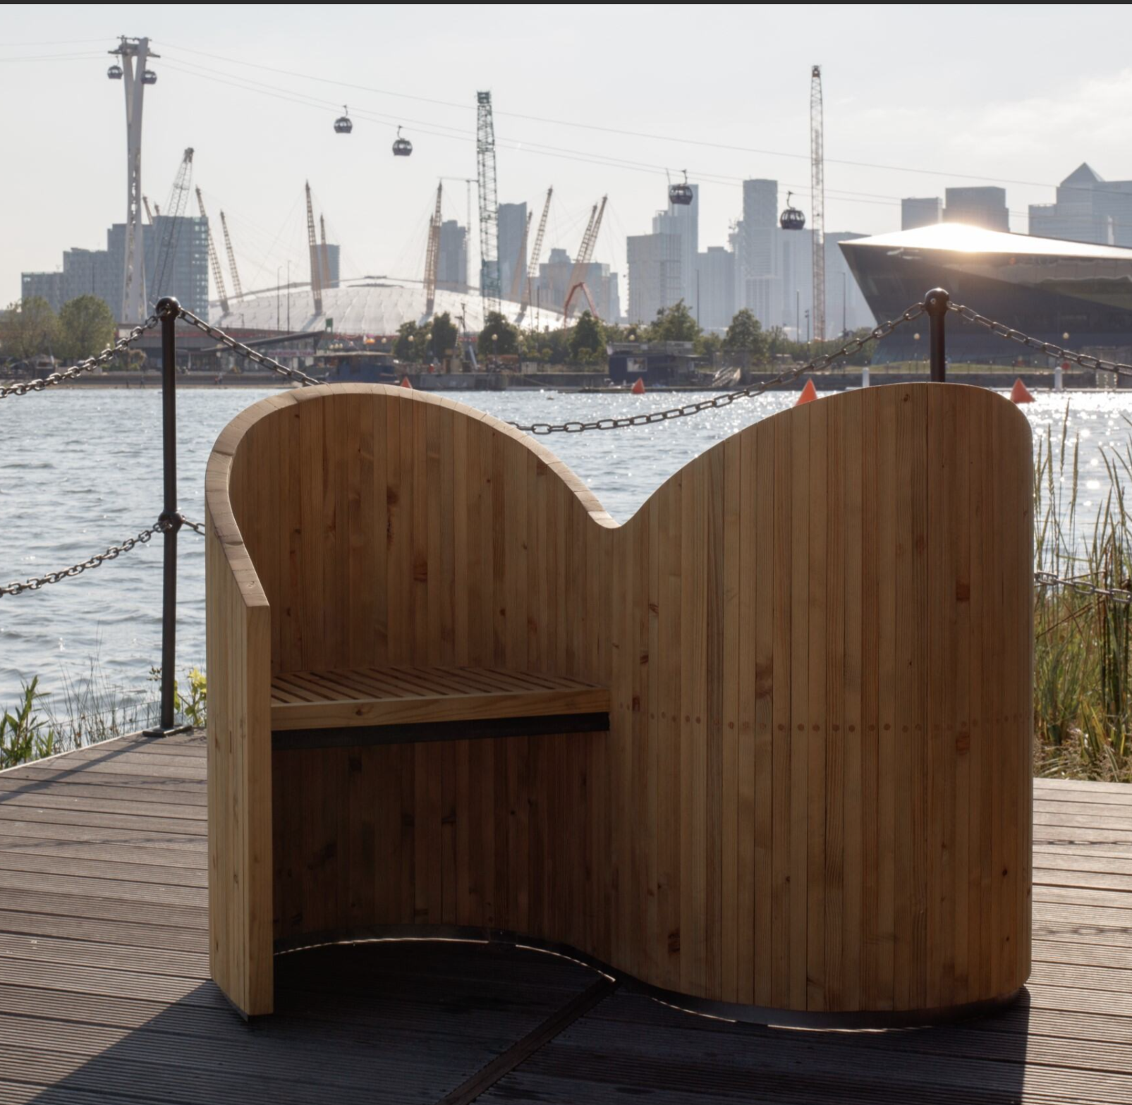
The Mayor is looking to appoint three Members
with expertise in one or more of the following:
• economic growth and development
• the night-time economy, retail, hospitality
• social infrastructure
• environmental sustainability
• cultural placemaking
• marketing
• community engagement.

Slide 12
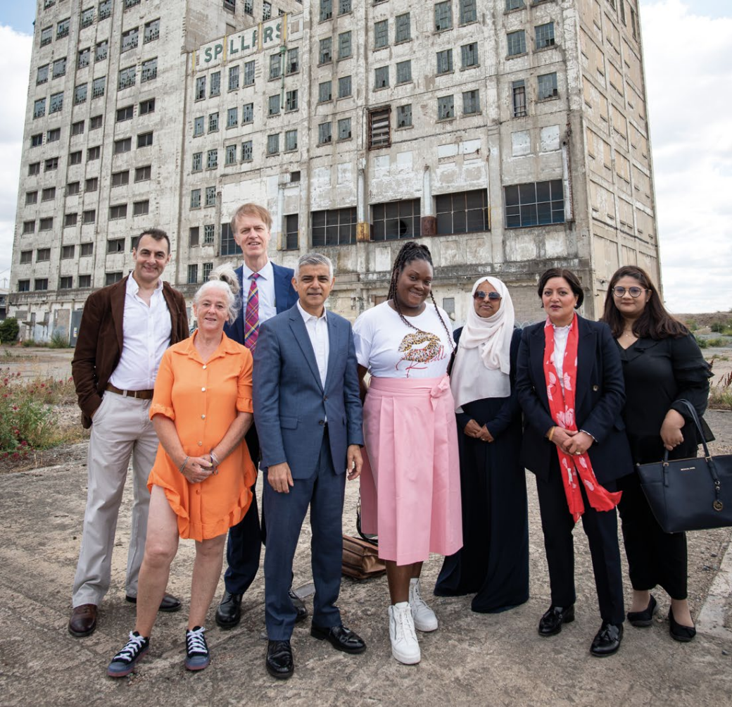
3. Membership and Governance
The Royal Docks Enterprise Zone Programme Board is a partnership board between the London Borough of Newham and the Greater London Authority.
It comprises of up to eight members, including Trade Union Representation, and is co-chaired by Rokhsana Fiaz, Mayor of Newham, and Tom Copley, Deputy Mayor of London for Housing and Residential Development.

Slide 13
New Board Membership Composition
The future structure of the Royal Docks Enterprise Zone Programme Board will comprise the following eight positions:
Members | Role
Mayor of Newham | Co-Chair
Deputy Mayor of London for Housing and Residential Development | Co-Chair
Trade Union Representative | Board Member
Local Ward Councillor from Newham | Board Member
3 new representatives covering the three outcomes | Board Member x 3
A young person representative from the local area | Youth Board Member

Slide 14
New Board Membership Composition
Role | Board Member x3
Time Commitment | 2 – 4 hours on a quarterly basis
Start Date | Expected to start from January 2025
Duration | Initial 2-year term (option for another 2-year extension based on good governance practices)
Appointment | Appointment by the Mayor of London
Location | City Hall (Royal Victoria Dock) and Newham Dockside (Royal Albert Dock)
Expenses | Eligible for remuneration and expenses (see remuneration section below)

Slide 15
4. Role Specification
The role
We are seeking to appoint three Members to the Board who, collectively, will bring expertise in all three strategic outcomes.
Members must have a deep understanding of the opportunities and challenges associated with achieving these outcomes.

Slide 16
Duties
• Attend and contribute to quarterly Board meetings, having prepared appropriately. Meetings are usually held quarterly. Attend and contribute to any sub-groups as assigned
• Provide leadership and strategic direction to the Royal Docks Team and drive forward regeneration and economic growth opportunities within the Royal Docks
• Oversee the implementation of the Royal Docks Delivery Plan and monitor the delivery and performance of the Royal Docks Team
• Contribute to the development of strategies, policies and plans, including taking a role in developing a long-term vision for economic development across the Royal Docks
• Ensure that the Board, in reaching decisions, acts consistently with the GLA’s statutory obligations and the GLA’s decision-making framework
• Promote a high standard of decision making and oversight of the administration of any funds distributed by the Board including retained business rates in the Royal Docks Enterprise Zone
• Ensure that the diversity of London’s communities and economy is reflected in the work of the Board
• Represent the Board and act as an ambassador for the Mayor and London.

Slide 17
Criteria
To fulfil the role of Member, applicants will have:
• Senior and substantial experience in their relevant sector
• An ability to contribute effectively in developing strategy
• An ability to drive improvement in the delivery and implementation of the five-year delivery plan
• High level experience of representing and/or influencing bodies
• An ability to represent the Mayor and the Board effectively to external stakeholders
• An ability to act as a conduit between the Board and their respective professional communities
• An ability to engage the confidence of the Mayor and represent his vision, values and objectives.
• The capacity to contribute analysis and insight at different scales: regional, pan-London and local.

Slide 18
Profile of successful candidates
We are looking to appoint three Members with expertise in one or more of the following sectors:
• economic growth and development
• the night-time economy, retail, hospitality
• social infrastructure
• environmental sustainability
• cultural placemaking
• marketing and communications
• community engagement
Our ambition is that one appointee will particularly champion progress
against a key outcome most relevant to their background:

Slide 19
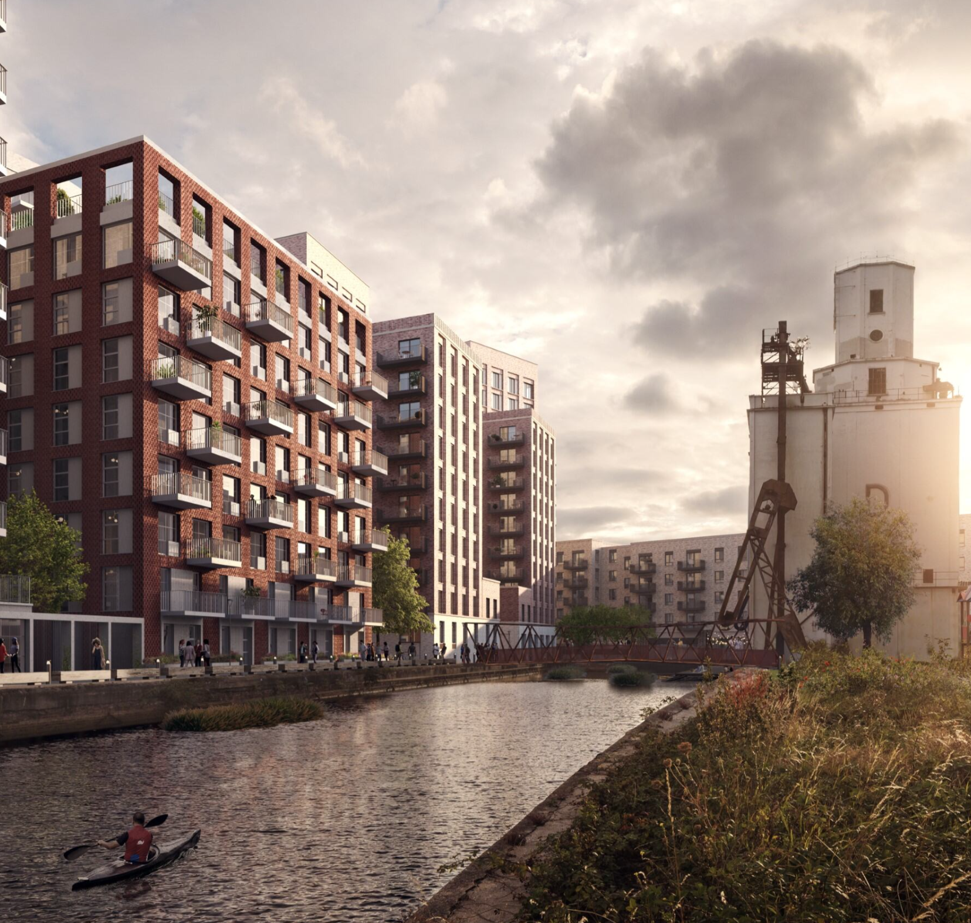
1. Prosperity, Growth & Investment
We are looking for someone with economic development expertise spanning employment and skills, business support and area-based regeneration.
With experience of delivering a significant strategy or programme, you will have led project development and management, worked closely with the community, consultant teams and a diverse range of partners as well as budget oversight responsibilities .

Slide 20
2. Sustainability & Wellbeing
We are looking for someone with significant experience of regeneration or development, including the management of large projects from initiation to completion.
Significant experience with sustainable development and an understanding of the principles of place-making are essential.

Slide 21
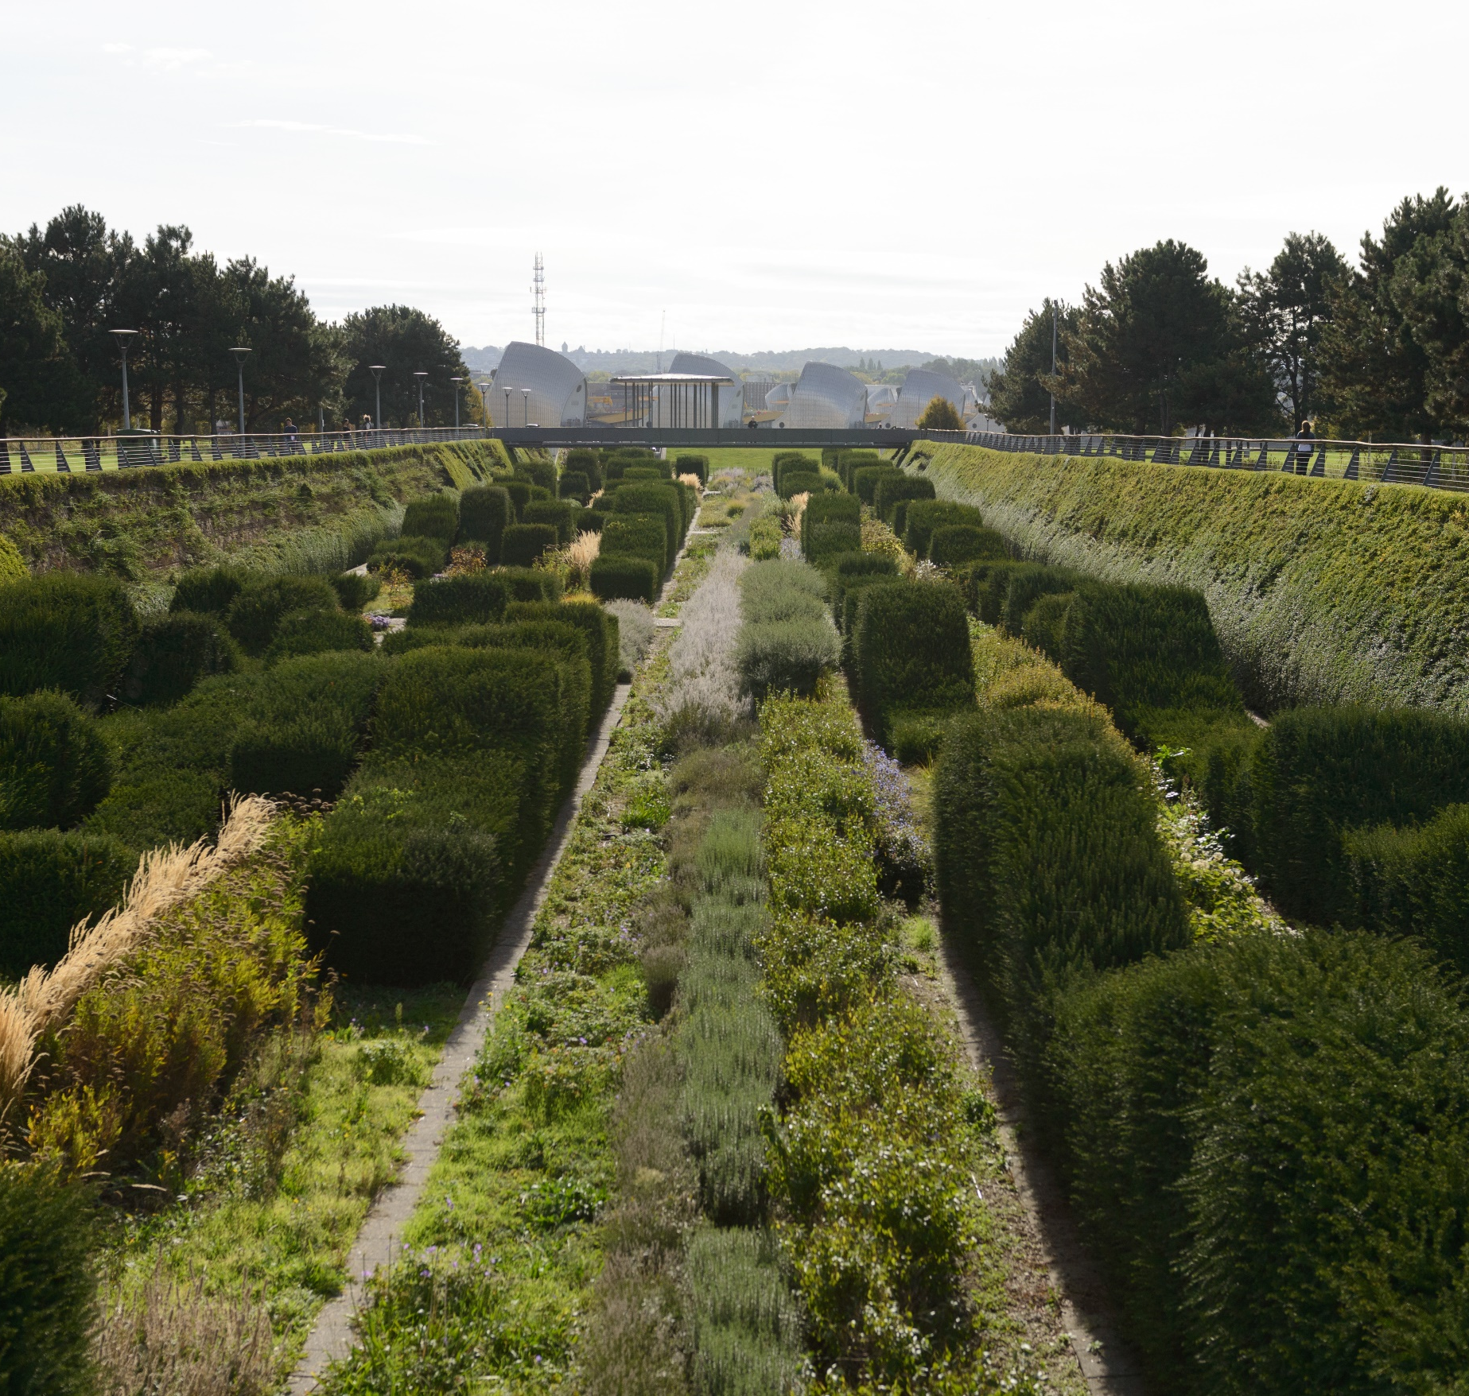
2. Sustainability & Wellbeing
You will also bring experience of collaborating with a diverse array of partners and communities towards these aims.
Our ambition is for the Royal Docks to lead the way in sustainable investment and development, with six distinct waterside neighbourhoods that provide resilient, vibrant, and healthy places, where both nature and residents can thrive.

Slide 22
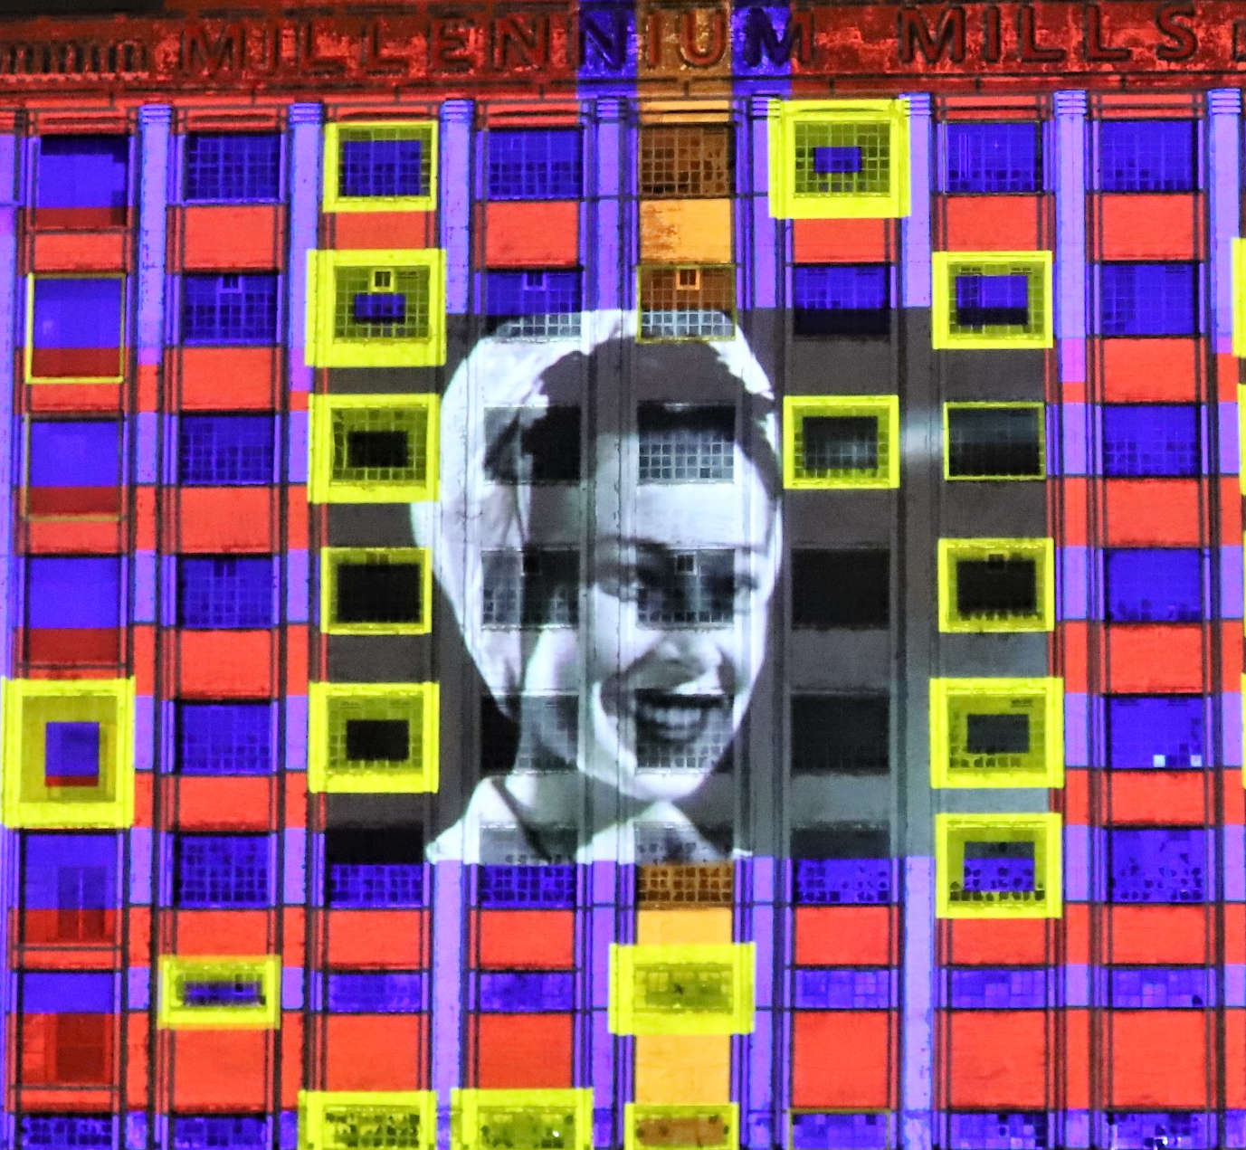
3. Culture & Community
From animating key sites and attracting large-scale public events, to fostering community arts participation, your challenge is support us in positioning the Royal Docks as a world-class cultural and commercial destination through marketing, communications, and the strategic development and implementation of a complex cultural place-making programme.

Slide 23
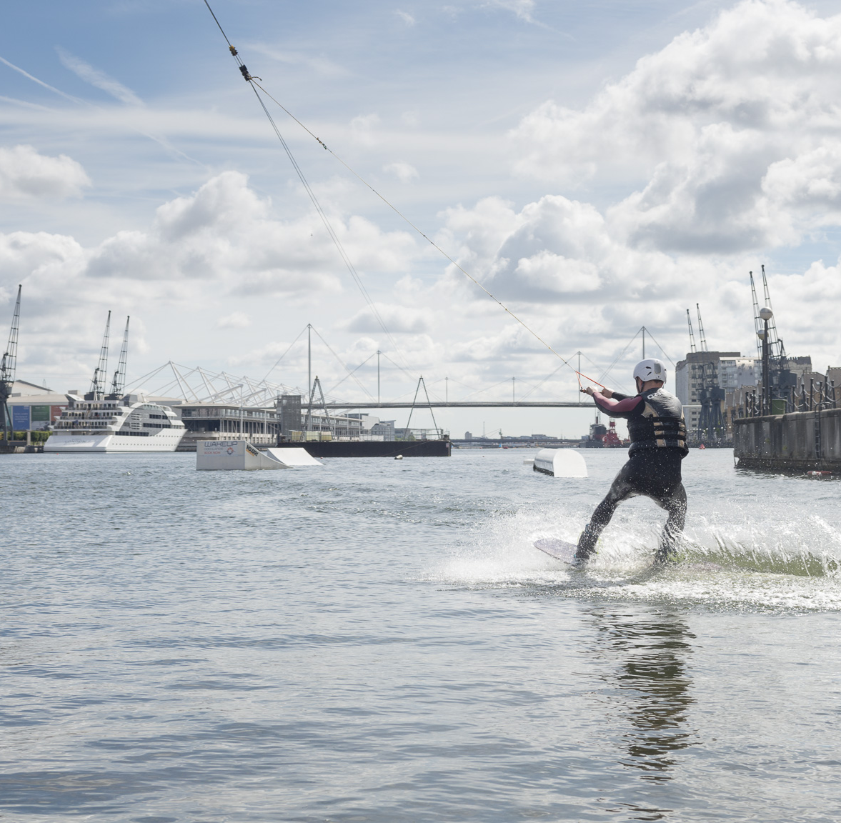
3. Culture & Community
This will include working in partnership with a diverse stakeholder group to attract local, national and international audiences.
We are looking for someone with significant experience at a senior level within a high-profile organisation, with a proven track record in managing the delivery of complex cross-organisational projects.
This should ideally include the management of politically sensitive strategic programmes and events, and a track-record in delivering a sponsorship or fundraising income stream.

Slide 24
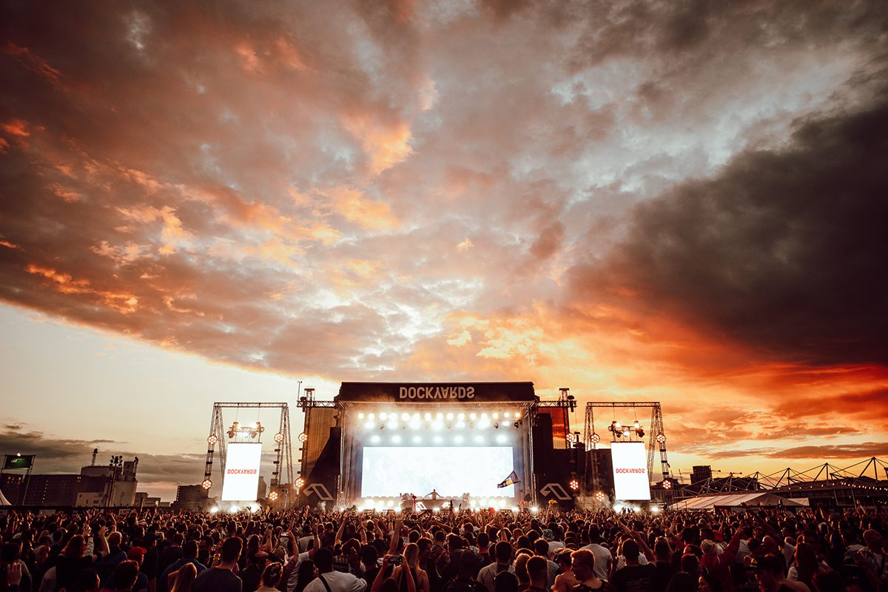
The successful candidates will be the individuals who best meet the criteria listed in the role specification above and have relevant expertise or understanding of one or more of the sectors identified above.
We are particularly interested in applicants who live or work in east London from the business, voluntary or community sectors, including a prominent member of the Newham business community.
We strongly welcome and encourage applications from individuals who identify as female, come from culturally diverse backgrounds, or have a disability.

Slide 25
5. Appointment Details
Time Commitment
The Board meets quarterly at the Royal Docks (Newham Dockside or City Hall).
Remuneration and Expenses
Members may be able to claim a stipend of £50 per hour (e.g. if unemployed, freelance in education, or on the National / London Living Wage.) up to £200 per meeting.
Members are entitled to reimbursement for reasonable travel expenses incurred in the performance of their role, in line with the GLA’s Expenses and Benefits Framework.
Term of the Appointment
The term of the appointment will be specified by the Mayor but is likely to coincide with the current London Mayoral term, which ends in May 2028. The appointment will be structured as an initial two-year term, with an option for a two-year extension based on good governance practices.
Start Date
Appointees are expected to be available to take up their role from January 2025.

Slide 26
6. Appointment Process
Following assessment of applications against criteria for appointment, shortlisted applicants will be interviewed by a selection panel. The panel will make recommendations for appointment to the Co-Chairs of the Board.
The GLA promotes an equal opportunities policy. Appointments are made on merit following a fair and transparent process and are governed by Nolan principles and the Mayor of London’s Protocol on Mayoral appointments. Please view our Protocol on Mayoral appointments for further details.
The Mayor of London will confirm appointments to the Board.

Slide 27
How to Apply
CV and cover letter (1,500 words max) via our online recruitment system.
The covering letter should provide details of the relevant experience addressing the criteria listed in the role specification (see Application Pack).
Closes: Sun 10 November, 23:59 GMT.
Apply online [Board Member - Royal Docks Enterprise Zone Programme Board (engageats.co.uk)]

Slide 28
Notes on applying
The CV must include details of employment, public appointments, directorships and qualifications; the name and contact details of two referees; and any relevant information regarding eligibility for appointment.
For a confidential discussion about the positions, please contact Daniel Bridge on Daniel.bridge@london.gov.uk
All data will be processed in accordance with the provisions of the Data Protection Act.

Slide 29
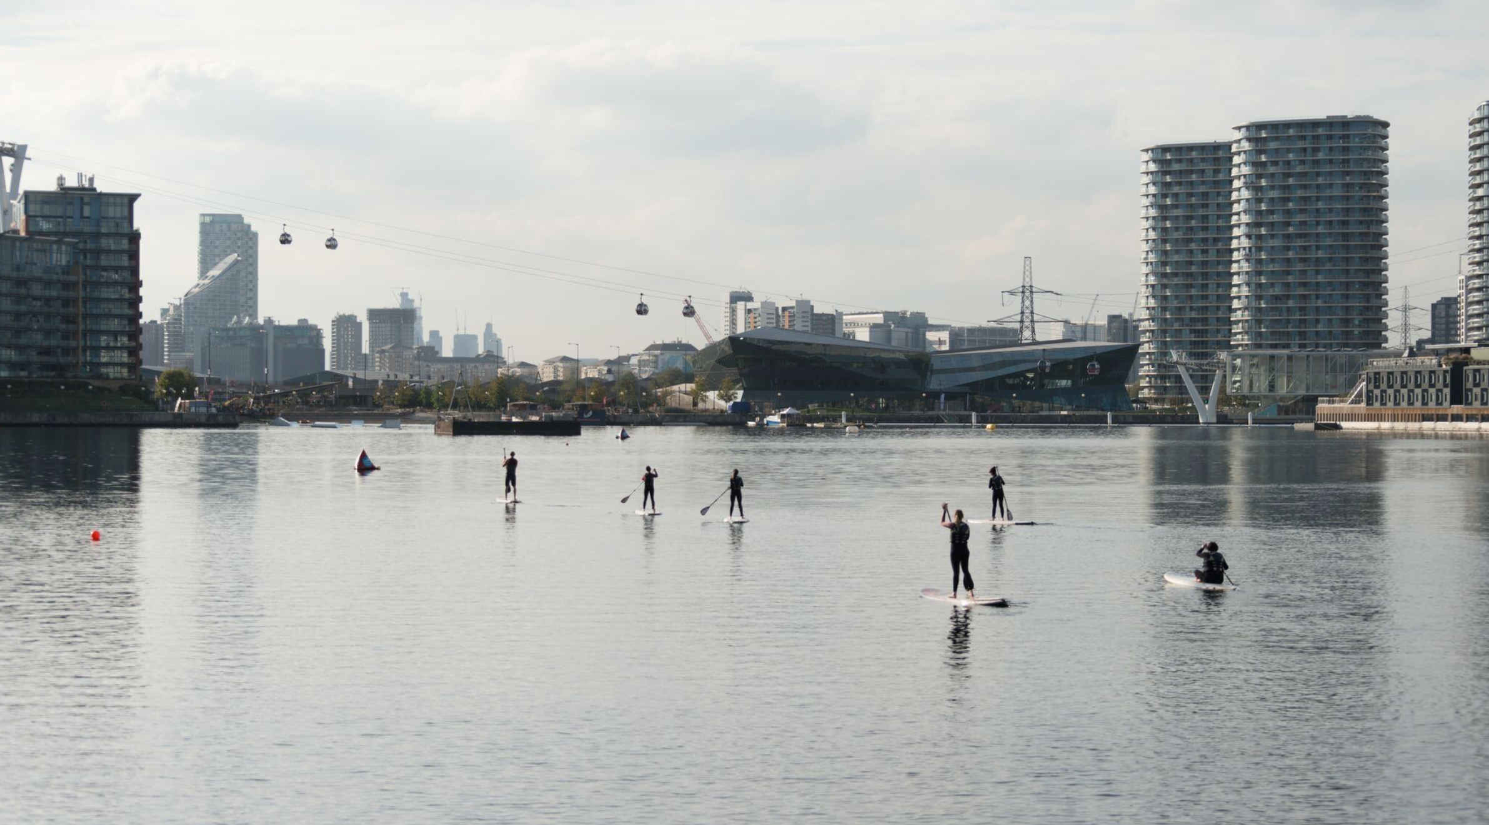
Thank you for taking the time to apply for this role. royaldocks.london | @yourroyaldocks

